Slide 1
Bullet graph

Slide 2

Introduction
A bullet graph is a bar marked with extra encodings to show progress towards a goal or performance against a reference line.
A reference line, denoting a goal or other critical threshold, is set perpendicular to the bar on the axis with the quantitative scale.
When the main bar passes the reference line the goal has been met or the state has changed.

Slide 3
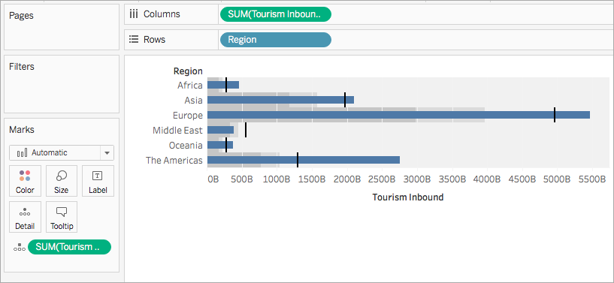

Slide 4
https://help.tableau.com/current/pro/desktop/en-us/qs_bullet_graphs.htm#:~:text=A%20bullet%20graph%20is%20a,sales%20compared%20to%20estimated%20sales.

Slide 5
Stacked Area Chart

Slide 6
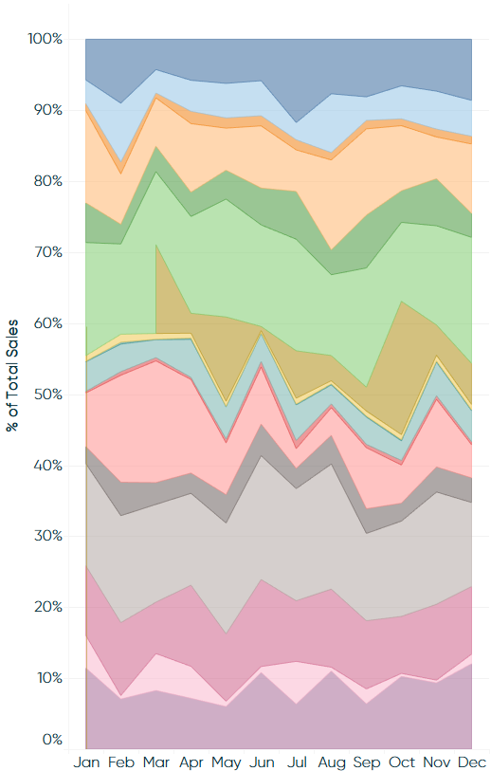
Introduction
A stacked area chart ‘stacks’ trends on top of each other to illustrate how a part-to-whole distribution is changing over time.
Stacked area charts are an effective way to evaluate distributions.

Slide 7
https://help.tableau.com/current/pro/desktop/en-us/qs_area_charts.htm

